Slide 1
Clang的RISCV支持 PLCT实验室 史宁宁 2020-02-18

Slide 2
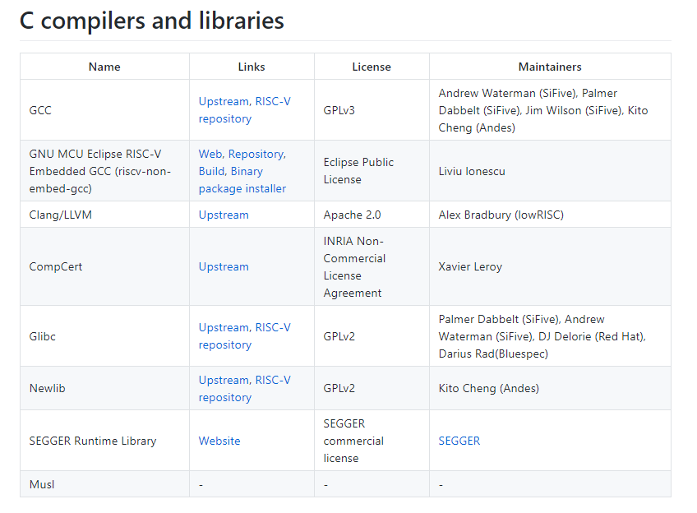
C类编译器和库的支持情况
From:
https://riscv.org/software-status/#c-compilers-and-libraries

Slide 3
About lowRISC
lowRISC is a not-for-profit company using collaborative engineering to develop and maintain open source silicon designs and tools, through a unique combination of skills, expertise and vision.
lowRISC employs an engineering team in Cambridge, UK, working on our own developments, partner projects, and work-for-hire that is aligned with our mission.
lowRISC is a Founding member of the RISC-V Foundation.
From: https://www.lowrisc.org/about/

Slide 4

About lowRISC
From: https://riscv.org/membership/1001/lowrisc-2/

Slide 5
The History of lowRISC
lowRISC emerged from the University of Cambridge Computer Lab, where our early work was supported by a private donation and a grant from Google.
Since 2018 we have focussed on collaborative engineering on active open source silicon projects with multiple partners, and on supporting and stewarding open source compiler infrastructure and tools.
We still work closely with the University of Cambridge, as well as other academic and corporate partners, and the wider open source community.

Slide 6
Clang for RISCV
Driver部分
clang/lib/Driver/ToolChains/RISCVToolchain.h
clang/lib/Driver/ToolChains/RISCVToolchain.cpp
clang/lib/Driver/ToolChains/Arch/RISCV.h
clang/lib/Driver/ToolChains/Arch/RISCV.cpp
Basic部分
clang/lib/Basic/Targets/RISCV.h
clang/lib/Basic/Targets/RISCV.cpp
CodeGen部分
clang/lib/CodeGen/TargetInfo.cpp

Slide 7
LLVM for RISCV
Target部分
llvm/lib/Target/RISCV/*

Slide 8
Clang for RISCV
clang/lib/Driver/ToolChains/Arch/RISCV.cpp
涉及到多个扩展的支持，组建工具链。目前仅能支持：m、a、f、d、c。
1、可以继续做的工作：完善对所有扩展的支持（受限于后端的支持程度，如果后端没支持该扩展，review的时候可能不会同意添加新的扩展）
2、对于riscv版本数字编号的检测
https://reviews.llvm.org/D73891
实现了1中的b扩展，以及2中的数字编号的检测。
3、各个扩展之间的限制规则的检测
比如支持d的时候必须要求支持f，该规则已经实现，但是还有类似规则需要实现。
上述各点涉及到的代码主要在：
static bool getArchFeatures(const Driver &D, StringRef MArch,
std::vector<StringRef> &Features,
const ArgList &Args)

Slide 9
Clang for RISCV
Basic部分
clang/lib/Basic/Targets/RISCV.h
clang/lib/Basic/Targets/RISCV.cpp
https://reviews.llvm.org/D71553

Slide 10
Thanks!

